Slide 1
Geological setting and mineralisation style of the Augusta antimony-gold deposit: Costerfield region, central Victoria
Cael Gniel, Thomas Fromhold and Christopher Davis

Slide 2
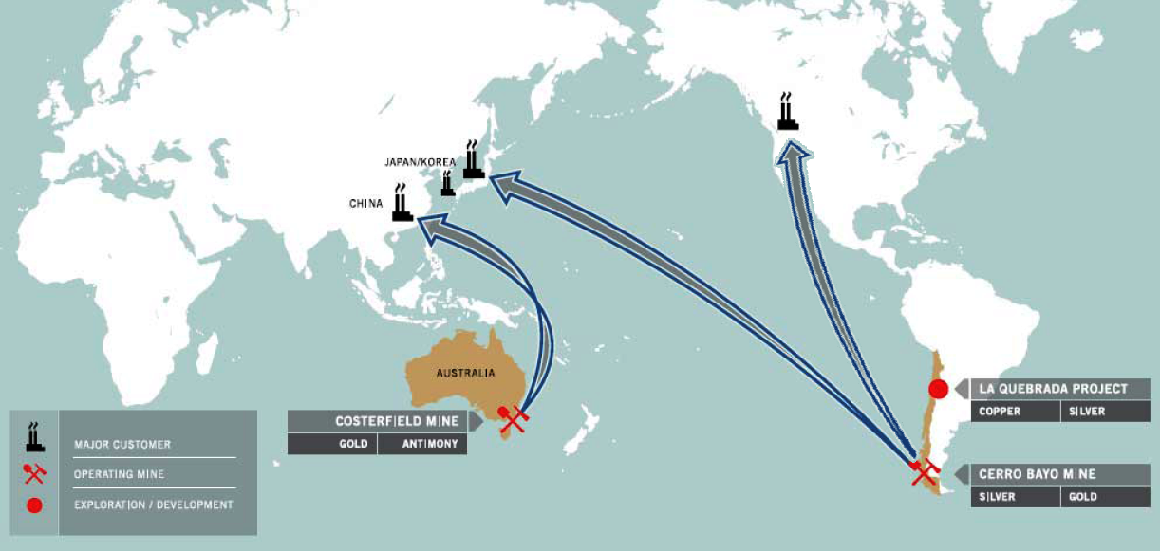
Mandalay Resources
Registered on the TSX and has 100% Ownership of 3 Projects:
Chile Cerro Bayo Silver-Gold Mine and Exploration
La Quebrada Copper-Silver Exploration
Australia Costerfield Antimony-Gold Mine and Exploration
50,000 AuEq oz pa

Slide 3
Contents
Introduction
Geological Setting
Stratigraphy
Structural Geology
Augusta
Cuffley
Mineralisation
Conclusion

Slide 4
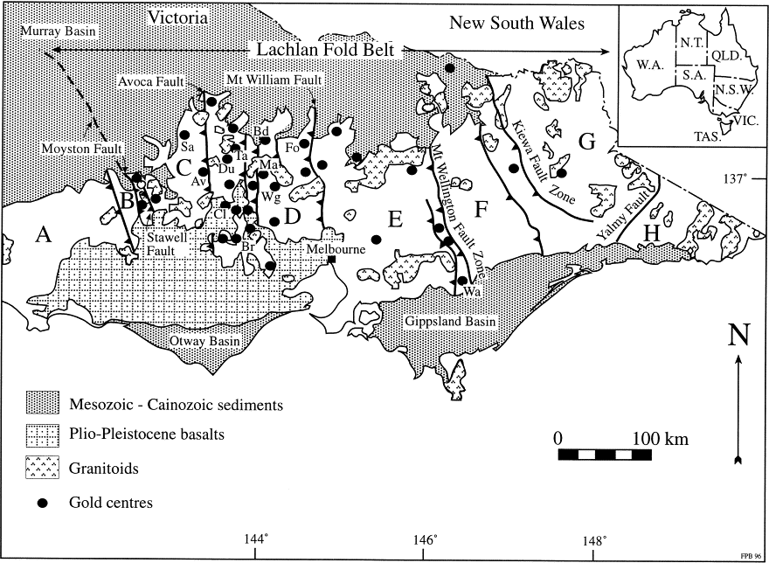
Introduction
Modified from Bierlein et al., 1998

Slide 5
Geological Setting

Slide 6
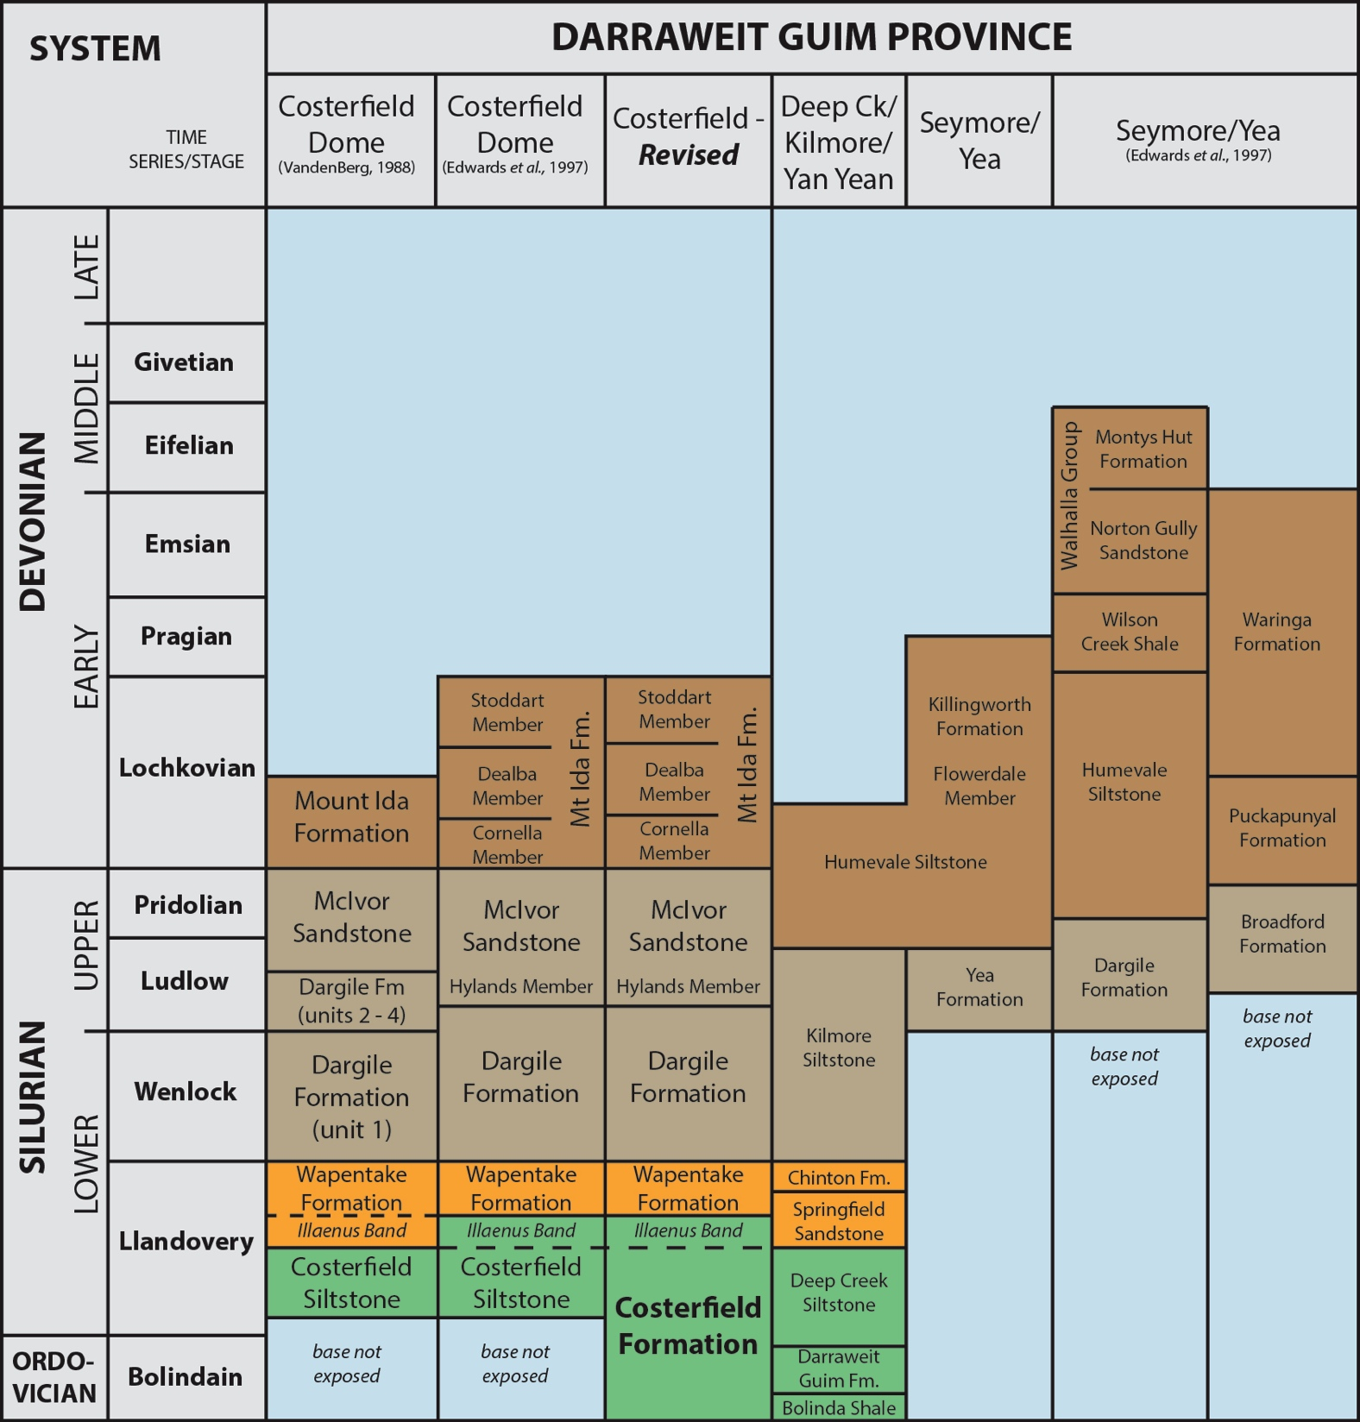
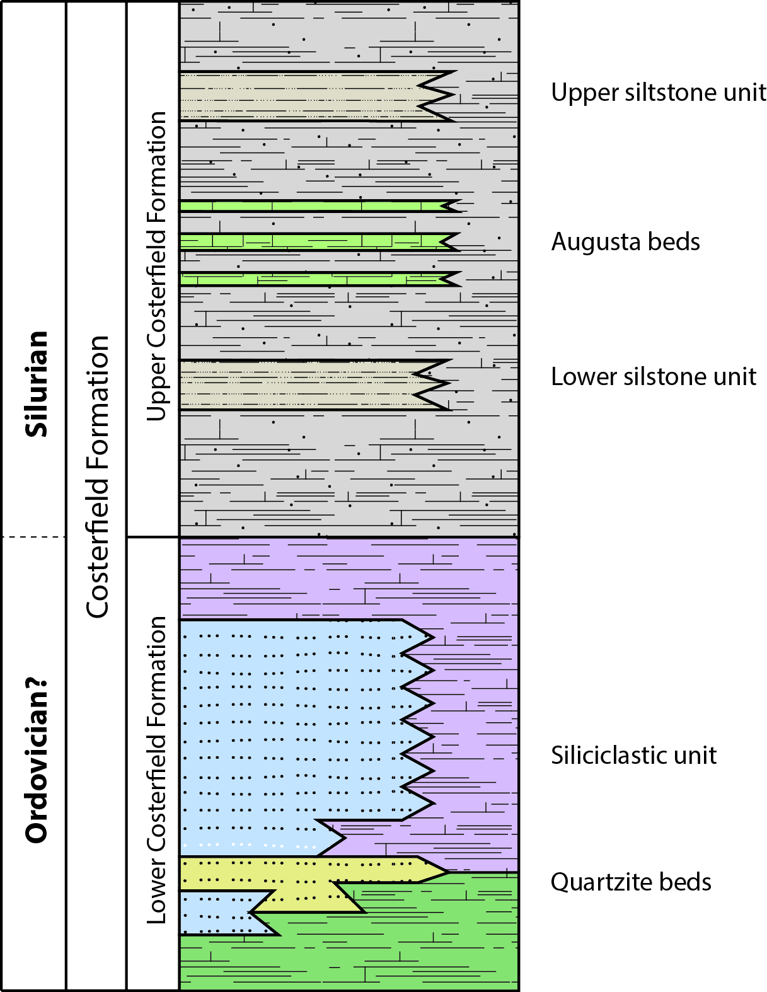
Costerfield Fm. Stratigraphy

Slide 7
Structural Geology

Slide 8
Augusta Deposit

Slide 9
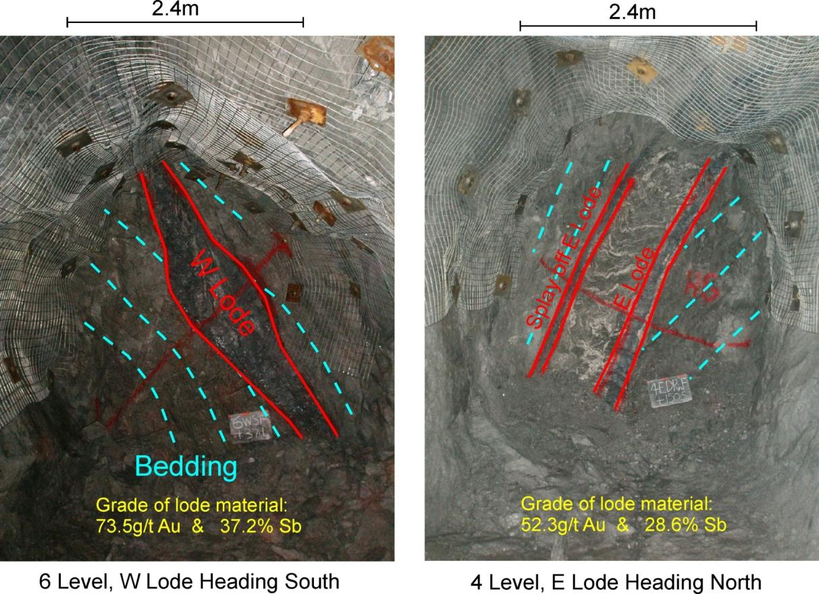
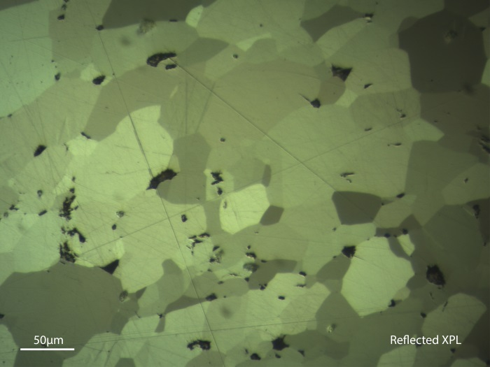
E and W lodes
E lode – average 39g/t Au & 22% Sb
W lode – average 62g/t Au & 29% Sb
Fault hosted

Slide 10
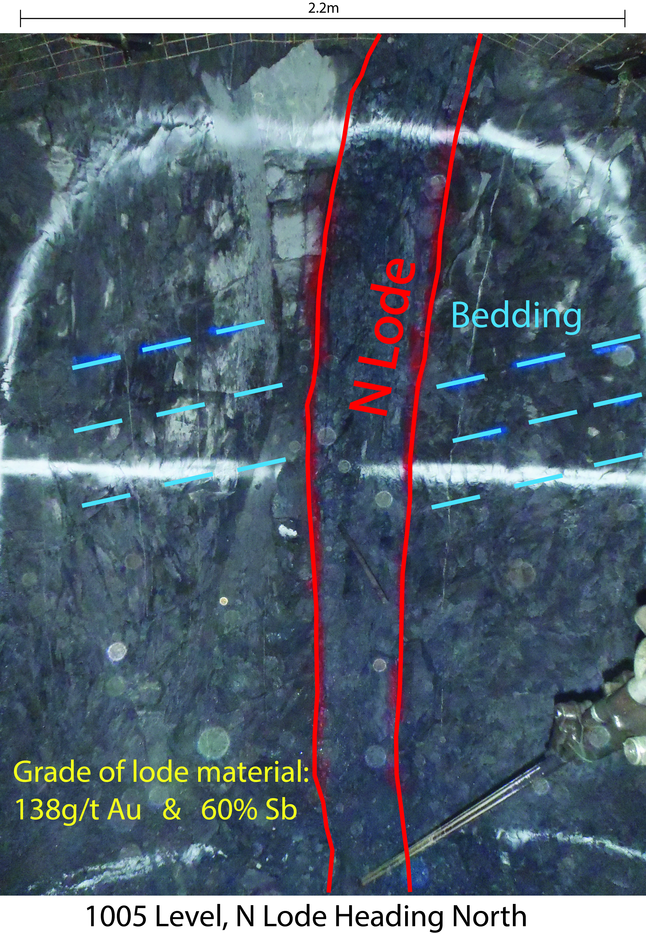
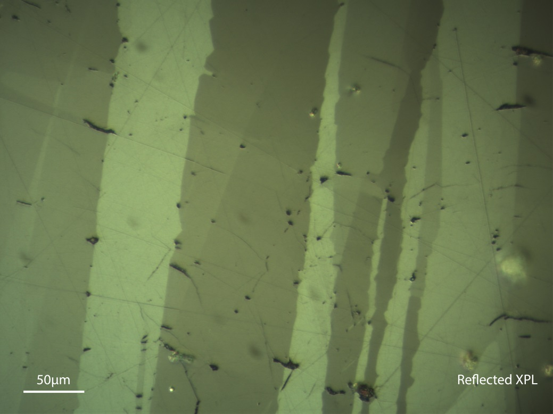
N lode
Ave – 55g/t Au and 25% Sb
Primary structure(syn-mineralisation)

Slide 11
Cuffley Deposit
Mining to commence in late 2013
Appears to be similar to N lode
Primary structure(syn-mineralisation)

Slide 12
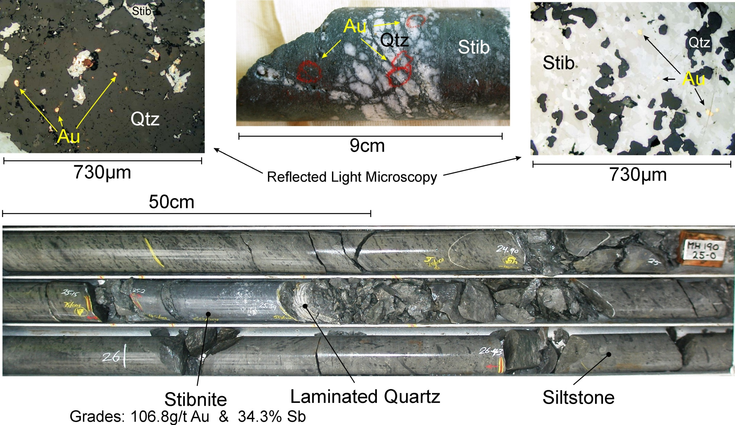
Mineralisation

Slide 13
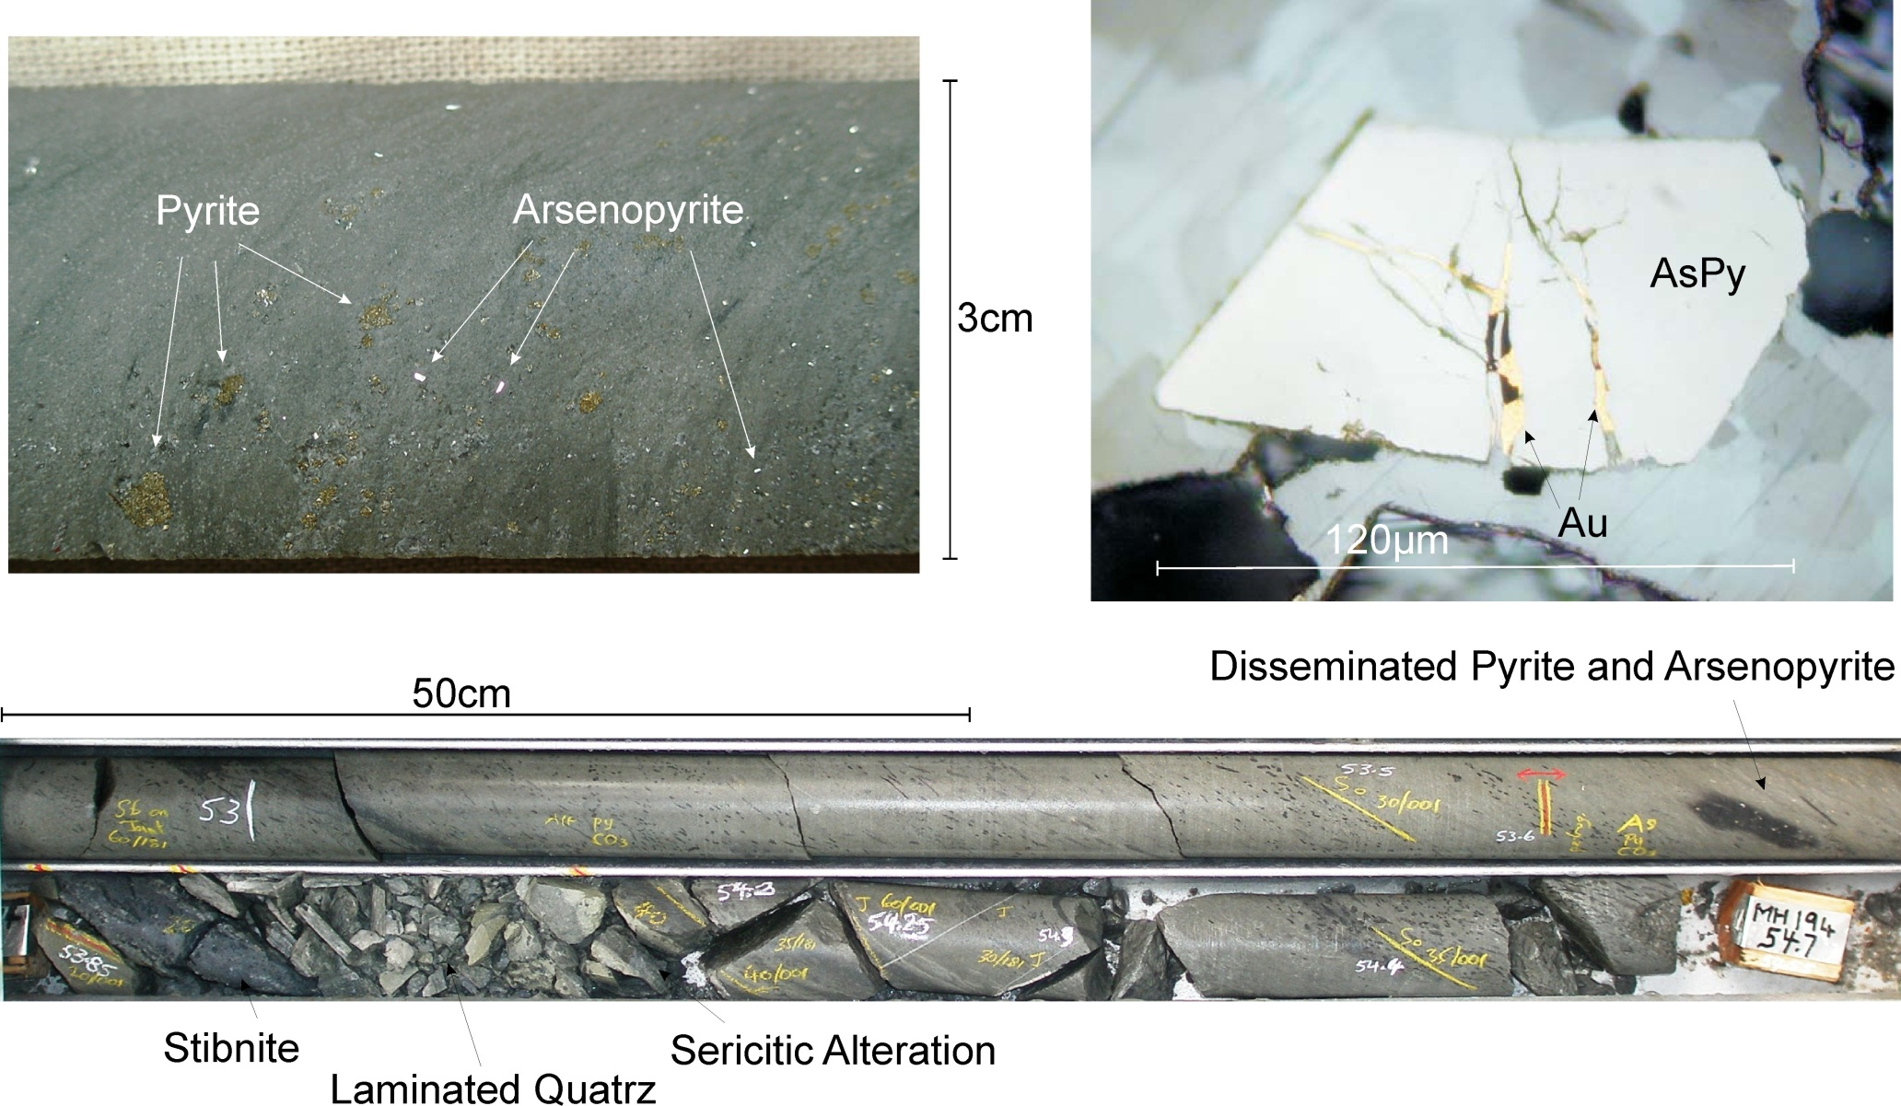
Mineralisation
Stibnite
Laminated Quartz
Sericitic Alteration

Slide 14
Paragenetic Sequence

Slide 15
Conclusion
Host sediments are early silurian-aged (and possibly older), interbedded, variably calcareous and pyritic mudstones of the Costerfield Formation.
Mineralised domain resides within Tabberabberan thrust structures.
Lodes occupy pre-existing thrust structures and syn-mineralisation cavities.
Stibnite/Gold mineralisation. Gold occurs in both free and refractory forms. Stibnite occurs as microcrystalline and sparry forms.
No correlation between quartz content and gold grade.

Slide 16
References
Bierlein, F.P., Fuller, T., Stüwe, K., Arne, D.C., Keays, R.R., 1998. Wallrock alteration associated with turbidite-hosted gold deposits. Examples from the Palaeozoic Lachlan Fold Belt in central Victoria, Australia Ore Geology Reviews 13, 345–380.
VandenBerg, A.H.M., Willman, C.E., Maher, S., Simons, B.A., Cayley, R.A., Taylor, D.H., Morand, V.J., Moore, D.H. & Radojkovic, A., 2000. The Tasman Fold Belt System in Victoria. Geological Survey of Victoria Special Publication.

